Slide 1

Making this resource work for you
Prior to teaching this lesson, please refer to the ‘Unit Overview and Planning Document’.
Further guidance on planning Science Mastery lessons can be found in the detailed planning guidance document.
Refer to the ‘notes’ section on each slide for useful information, including suggested expositions, pedagogical content knowledge, suggested questions, answers and more. Consider using presenter mode so you can see this guidance throughout the lesson.
The introduction slides can be adapted to suit your teaching style and the needs of your class.
Before the lesson, adapt the fix-it slide to address any misconceptions identified in the previous lesson’s exit ticket.
Choose from the suggested activities to suit your class. The intention is not that you complete all of these, but that you select those which ones are most appropriate for your students. It may be appropriate to further adapt activities for your students.
These lessons are designed to occupy approximately 1 hour. To adapt for a shorter or longer lesson duration we advise you to adapt the activity section accordingly.
Please consider using the final slide to send feedback about this lesson or examples of PowerPoints that you have adapted to our design team. Your feedback is used to improve Science Mastery for all of our teachers and students. We appreciate all suggestions and comments.
Thank you for reading!
The Science Mastery Team

Slide 2
Eukaryotic and Prokaryotic Cells
Answer the questions below.
Explain how neurons are well suited for their function.
Explain the difference between the coarse focusing wheel and the fine focusing wheel of a microscope.
State the word equation for aerobic respiration.
Explain why it is incorrect to say that energy is made during respiration.
Name the organelles that are found in plant cells only.
They have long axons and dendrites so they can pass messages over long distances.
The coarse focusing wheel is used to roughly focus on a specimen (bring it into view) and the fine focus wheel is used to focus the image more sharply.
Glucose + oxygen → carbon dioxide + water
Energy is released during respiration but it cannot be created or destroyed.
Chloroplasts, cell wall, vacuole
Notes:
Foundation: Name the organelle that is the site of photosynthesis.
Stretch: Red blood cells have an extremely large surface area. How does this help them carry out their function?
Answers:
Foundation: Chloroplast
Stretch: This allows them to carry as much oxygen as possible around the body to take to the cells for respiration.

Slide 3


B3.1.2
16/10/2024
Eukaryotic and Prokaryotic Cells
B3.1.1 Prior Knowledge Review
B3.1.2 Eukaryotic and Prokaryotic Cells
B3.1.3 Aseptic Technique
B3.1.4 Growth of Bacteria
B3.1.5 Microscopes
B3.1.6 Observing Cells
B3.1.7 Diffusion
B3.1.8 Diffusion in Living Things
B3.1.9 Osmosis
B3.1.10 Osmosis Investigation
B3.1.11 Active Transport
B3.1.12 Cell Division
B3.1.13 Cancer
B3.1.14 Stem Cells
Notes:
Big Idea: Cells are alive
This is the first lesson of new content in this lesson. In it they will learn the differences between eukaryotic and prokaryotic cells. This is fundamental knowledge that will then be built on when looking at the growth of bacteria and comparing the features of eukaryotic and prokaryotic cells under a microscope and the uses of a light microscope vs an electron microscope.
Suggested Hook:
Pupils have learnt from Y7 that the nucleus contains the DNA in a cell. A good question to ask at the start ‘bacteria cells do not have a nucleus, so how is the cell controlled? Do you think they still have DNA?’ Yes they do have DNA just not inside a nucleus.

Slide 4

Following this lesson, students will be able to:
State examples of eukaryotic and prokaryotic cells
Describe the differences between eukaryotic and prokaryotic cells
Explain why prokaryotic cells do not contain mitochondria
Key Words:
eukaryotic
prokaryotic
nucleus
ribosomes
plasmid
organelle
mitochondria
flagella

Slide 5
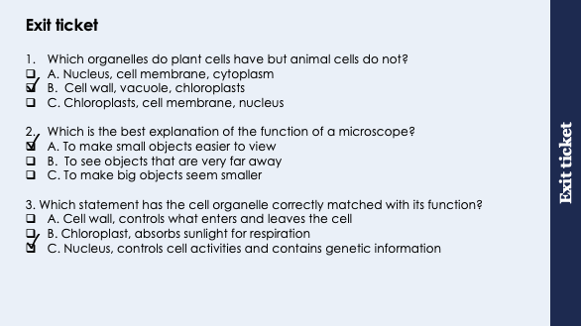
This is the fix-it portion of the lesson
The fix-it is an opportunity to respond to gaps in knowledge, especially those identified by the previous lesson’s exit ticket.
The teacher should customise this slide as needed, to facilitate
reteach, explanation, demonstration or modelling of ideas and concepts that students have not yet grasped or have misunderstood.
practise answering specific questions or of key skills.
redrafting or improving previous work.
Notes:
Purpose: to spend time on any gaps identified in previous learning from exit ticket feedback.
Suggested guidance for fix-it next lesson:
Q1. Answer: B
If pupils got Q1 wrong they have misconceptions around animal v plant cells. To fix it practice drawing animal and plant cells, with labels and functions of each organelle. Model drawing a plant and an animal cell and asked to identify which one is which and why- citing the extra organelles in plant cells as reasons. Alternatively use resources from B1.1 Cells unit.
Q2. Answer: A
If pupils got Q2 wrong their misconception is around why microscopes are used. If the answered B they could have confused with a telescope. To fix it, it could be useful to go through ‘The Scale of the Universe’ https://htwins.net/scale2/ to help pupils understand very small and very large objects. B suggests pupils are thinking of a telescope.
Q3. Answer: C
If pupils got Q3 wrong they have misconceptions around the functions of organelles. To fix it pupils need to practice questions on the functions of organelles. A match up task of organelles and functions would be an appropriate task or again use resources from unit B1.1.

Slide 6
Eukaryotic Cells
There are two types of cell – eukaryotic and prokaryotic.
Plant and animal cells are eukaryotic.
Ribosome
Cytoplasm
Eukaryotic cells contain genetic material (DNA) within their nucleus.
Nucleus
Cell membrane
Mitochondrion
An organelle is a part of a cell that carries out a specific function.
The organelles in eukaryotic cells are contained within membranes.
Eukaryotic cells usually contain mitochondria to release energy for the cell through aerobic respiration.
Eukaryotic cells also contain ribosomes which are the site of protein synthesis.
Eukaryotic cells are typically between 10-100 μm in size.
Notes:
Purpose: to spend time on any gaps from B1.1.
Exposition type: Explanation
Suggested Script:
In year 7 we learnt about plant/animal cells and how cells are arranged to form either multicellular or unicellular organisms. Now we are going to further categorise the types of cell we have learnt. The first type is a eukaryotic cell or a eukaryote. Get pupils to repeat the word 'I say, you say eukaryotic then eukaryote'. Both plant and animal cells are eukaryotic cells, we know that they both contain DNA found in the nucleus. A nucleus is an example of an organelle which is a part of a cell that carries out a specific function. There are other organelles present in both animal and plant cells. What organelles are found in both plant and animal cells? Nucleus, mitochondria (pupils will also mention cell membrane and cytoplasm). What organelles are only found in plant cells? Chloroplast, vacuole (pupils will also mention cell wall).
Organelles in eukaryotic cells are membrane bound meaning they are encased in a membrane. However, the ribosome, which is where proteins are synthesised (made) so are not membrane bound and are drawn as small dots in the cell (point to diagram).
Eukaryotic cells are the biggest kinds of cells we encounter and they range from 10-100um which is the equal to 0.01-0.1mm in size.
Eukaryotic cells make up all multicellular organisms (such as plants and animals) however there are many examples of unicellular organisms which are also made of eukaryotic cells (such as yeast and algae).
Suggested guidance: Pupils need to know the names and functions of each of the organelles and should be able to distinguish between organelles that are found in both animal and plant cells and those that are found in plant cells only.
Organelles = cell parts
μm = micrometer. This is equal to 1 x 10⁻⁶ m, or 0.000001 m
Quite good for wider knowledge to cover some word origins:
Eu (true/real)
Karyo (kernel/nut --> nucleus)

Slide 7
Prokaryotic Cells
ribosome
Bacterial cells are prokaryotic
Prokaryotic cells are much smaller than eukaryotic cells, typically 1-10 μm in size
Prokaryotic cells contain genetic material (DNA) in small rings called plasmids, or in larger loops
Both eukaryotic and prokaryotic cells contain ribosomes, which make proteins for the cell
cytoplasm
Prokaryotic cells do not contain a nucleus or membrane-bound organelles
DNA loop
plasmid
cell membrane
cell wall
Notes:
Exposition type: Explanation
Suggested Script:
The second type of cell to learn about is a prokaryotic cell or prokaryote. Get pupils to repeat the word 'I say, you say prokaryotic then prokaryote'. Prokaryotes are always unicellular organisms and never make up multicellular organisms, an example of a prokaryote would be any type of bacteria. Prokaryotes are much simpler and smaller than eukaryotes (which can make up complex multicellular organisms) and range from 1-10um which is equal to 0.001-0.01mm.
In contrast to eukaryotic cells, prokaryotic cells do not contain any membrane bound organelles meaning they do not contain a nucleus or anything similar. What other membrane bound organelles would not be present in a prokaryote? Chloroplast, mitochondria (pupils may say vacuole emphasise that prokaryotes do not contain permanent vacuoles although some bacteria can contain vacuoles).
As prokaryotes are living organisms and therefore reproduce they still contain genetic material, it is just not found inside a nucleus. Instead prokaryotes have free DNA inside the cytoplasm, it can be found as a large DNA loop or as smaller rings of DNA which are known as plasmids.
As ribosomes are not membrane bound they can be found in prokaryotic cells and have the same function of synthesising proteins. Some prokaryotes also have a flagella which is a tail-like structure that can help the cell to move and is particularly useful to bacteria that need to move or travel through liquids. Either annotate diagram or draw on whiteboard to show a simple flagella. Emphasise that this is not a tail but a tail-like or whip-like structure.
Show the video linked here: https://www.youtube.com/watch?v=dO2xx-aeZ4w watch until 1:45. Ask students whether this organism is Eukaryotic or prokaryotic.
Misconception: pupils have always been taught that cells are the simplest form of life and have previously focused mainly on animal and plant cells so can often assume that they would be the simpler of the two cell types.
Quite good for wider knowledge to cover some word origins:
Eu (true/real)
Karyo (kernel/nut --> nucleus)
also an opportunity to teach plural/singular latin i.e. mitochondria/mitochondrion or flagella/flagellum

Slide 8
State whether each statement is true or false.
Eukaryotic cells are bigger than prokaryotic cells
Prokaryotic cells contain their genetic information in a nucleus
Bacteria are prokaryotic cells
Plant cells are prokaryotic cells
Eukaryotic cells can contain mitochondria to provide energy through aerobic respiration
True
False
True
False
True
Notes:
Purpose: to check that key knowledge from the introduce phase has been learnt and understood
Suggested guidance:
Either get pupils to write answers in books or give thinking time before cold calling.
Answers:
True
False – eukaryotic cells contain nuclei, prokaryotic cells carry genetic information in plasmids
True
False – plant cells are eukaryotic
True

Slide 9

Is this correct?
Prokaryotic cells do not contain mitochondria because they do not respire.
Notes:
Suggested guidance: Make sure to emphasise that prokaryotic cells DO respire and prokaryotic cells do not contain mitochondria because they are roughly the same size as mitochondria (therefore mitochondria would not fit in prokaryotic cells). Respiration occurs in the cytoplasm of prokaryotic cells.
You can then introduce the theory that mitochondria are the result of prokaryotic cells at some point being engulfed to form a new eukaryotic cell.
Suggested guidance:
Talk tasks can be used in a variety of ways to suit the particular needs of the students you are teaching. Through exchanging views with others, students develop their understanding of the science beyond what could be achieved individually.
Science classrooms that successfully integrate talk have the following features:
Science talk is a regular feature of lessons and is woven into classroom activities.
Students are paired or grouped strategically by the teacher to ensure productive interaction. This might take into consideration the students’ proficiency of the English language, how encouraging they might be to peers and their attainment in the topic. It’s a good idea to consider these pairings in the class seating plan.
Students are encouraged and supported to talk, but are not forced to talk.
The teacher should take on the role of a facilitator, engaging with conversations where necessary and encouraging or steering the conversation where needed.
Students are encouraged to use the language they have to express their ideas (e.g., everyday language, imperfect English, native language), but also to incorporate science specific terminology where this is more accurate or has been taught.
6. Scientifically inaccurate ideas are not dismissed by the partner or teacher; open discussion and further investigation are relied on to help students construct ideas that support them to progress in their scientific understanding.
7. Guidelines for behaviour during talk tasks are explicit and frequently reviewed. Rules for students might be:
Listen carefully to your partner
Take turns talking.
Speak one at a time, without interrupting.
Politely agree or disagree and explain why.
Politely point out if your partner has used a scientific word incorrectly, if they have explained the science incorrectly, or if there is a more accurate way to describe something.
If confused, ask questions.
Stay focused on the discussion topic.
Respond to one another.

Slide 10
Drill
Where is the genetic material in eukaryotic cells found?
Where is the genetic material in prokaryotic cells found?
Which type of cell contains membrane-bound organelles?
What type of cell is a Salmonella bacterium?
What is the function of ribosomes in both prokaryotic and eukaryotic cells?
Which type of cell is larger, a eukaryote or prokaryote?
Name the cell structure in a eukaryotic cell where aerobic respiration takes place.
Give one difference between the structure of a bacterial cell and an animal cell.
Apart from a nucleus, what other membrane bound organelles would not be present in a prokaryote?
Notes:
Purpose: This is a knowledge drill. The purpose of this is to check that the critical knowledge is secure before pupils move onto independent practice.
Suggested guidance: There are a range of ways this could be done depending on time and ability range of the class:
Mini whiteboards
As full sentences in exercise books
As short answers in exercise books
In the pupil workbook
As pair talk
As cold call

Slide 11
Drill answers
Enclosed within the nucleus
Floating freely in the cytoplasm
Eukaryotic cells
Prokaryote
Ribosomes make proteins for the cell
Eukaryote
Mitochondria
Bacteria cell has cell wall / no nucleus / no mitochondria / plasmids present/ its DNA / genetic material is not enclosed / it has no nuclear membrane or converse.
Chloroplast, mitochondria
Notes:
Purpose: This is a knowledge drill. The purpose of this is to check that the critical knowledge is secure before pupils move onto independent practice.
Suggested guidance: There are a range of ways this could be done depending on time and ability range of the class:
Mini whiteboards
As full sentences in exercise books
As short answers in exercise books
In the pupil workbook
As pair talk
As cold call

Slide 12

I: Describing the function of organelles
Example question:
To ‘describe’, your answer should:
Use bullet points to keep your answer clear
Cover enough points to fully answer the question
Use scientific keywords in your answer
‘Say what you see’ if there is a diagram, graph or table.
Describe the difference in respiration between eukaryotic and prokaryotic cells.
Model answer:
In eukaryotic cells, respiration takes place in the mitochondria
Prokaryotic cells do not contain any membrane-bound organelles, so there are no mitochondria. In prokaryotes, respiration occurs in the cytoplasm.
Notes:
This slide models the process of answering a describe question.
Firstly, students are presented with a generic describe question, along with a model answer. Students are also given some simple guidance to follow for producing their own describe answer.
The generic question and answer should be used by the teacher to remind students of
the key features of a great answer
how to structure their answer
why the model answer is a good example
Following this, students will be required to apply this process to answer their own describe question, which will appear in place of the generic questions. This describe question will be specific to the topic students are learning about in the lesson. Give students time to write their own answer to this, ensuring that they use the guidance provided. To further scaffold this task for students, it may be appropriate to:
pair students up to write an answer together
list for students the key words you would like them to include in the answer
provide a writing frame or ‘points to include’ for students
A model answer for this question will appear. Teachers should review the model answer with students by referencing the guidance in the green box. For example ‘we can see item 1 in the guidance is to use bullet points to keep your answer clear. Notice in the model answer here we have done just that’. Or ‘item 2 in the guidance here says that we should use scientific keywords in the answer. Has this been achieved in the model answer? Where can we see this?’.

Slide 13
We: Comparing structural differences
Example question:
Describe the difference in genetic material between eukaryotic and prokaryotic cells
To ‘compare’, your answer should:
Give similarities.
Write paired statements that show differences relating to the same feature.
Use the term ‘whereas’ to link your statements.
Model answer:
In eukaryotic cells, the genetic material is within their nucleus
Prokaryotic cells do not have a nucleus. The genetic material is found in small rings called plasmids, or in larger loops.
Notes:
This slide models the process of answering a describe question.
Firstly, students are presented with a generic describe question, along with a model answer. Students are also given some simple guidance to follow for producing their own describe answer.
The generic question and answer should be used by the teacher to remind students of
the key features of a great answer
how to structure their answer
why the model answer is a good example
Following this, students will be required to apply this process to answer their own describe question, which will appear in place of the generic questions. This describe question will be specific to the topic students are learning about in the lesson. Give students time to write their own answer to this, ensuring that they use the guidance provided. To further scaffold this task for students, it may be appropriate to:
pair students up to write an answer together
list for students the key words you would like them to include in the answer
provide a writing frame or ‘points to include’ for students
A model answer for this question will appear. Teachers should review the model answer with students by referencing the guidance in the green box. For example ‘we can see item 1 in the guidance is to use bullet points to keep your answer clear. Notice in the model answer here we have done just that’. Or ‘item 2 in the guidance here says that we should use scientific keywords in the answer. Has this been achieved in the model answer? Where can we see this?’.

Slide 14
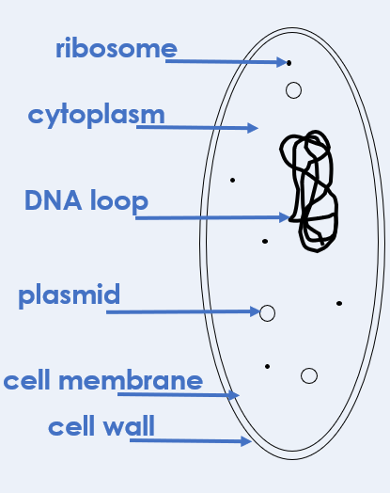
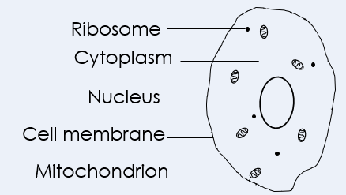
You: Describing differences
Example question:
Describe the differences between eukaryotic and prokaryotic cells
To ‘describe’, your answer should:
Use bullet points to keep your answer clear
Cover enough points to fully answer the question
Use scientific keywords in your answer
‘Say what you see’ if there is a diagram, graph or table.
Model answer (any of the following):
Prokaryotic cells do not have a nucleus, whereas eukaryotic cells do
Prokaryotes do not contain mitochondria (or any membrane bound organelles), but eukaryotes do
Prokaryotes do not have a nucleus, but eukaryotes do have a nucleus
Prokaryotes have plasmids (or small rings of DNA), eukaryotes do not
Prokaryotic cells are smaller than eukaryotic cells (or converse)
Notes:
This slide models the process of answering a describe question.
Firstly, students are presented with a generic describe question, along with a model answer. Students are also given some simple guidance to follow for producing their own describe answer.
The generic question and answer should be used by the teacher to remind students of
the key features of a great answer
how to structure their answer
why the model answer is a good example
Following this, students will be required to apply this process to answer their own describe question, which will appear in place of the generic questions. This describe question will be specific to the topic students are learning about in the lesson. Give students time to write their own answer to this, ensuring that they use the guidance provided. To further scaffold this task for students, it may be appropriate to:
pair students up to write an answer together
list for students the key words you would like them to include in the answer
provide a writing frame or ‘points to include’ for students
A model answer for this question will appear. Teachers should review the model answer with students by referencing the guidance in the green box. For example ‘we can see item 1 in the guidance is to use bullet points to keep your answer clear. Notice in the model answer here we have done just that’. Or ‘item 2 in the guidance here says that we should use scientific keywords in the answer. Has this been achieved in the model answer? Where can we see this?’.

Slide 15
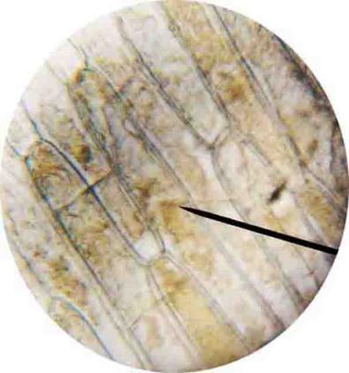
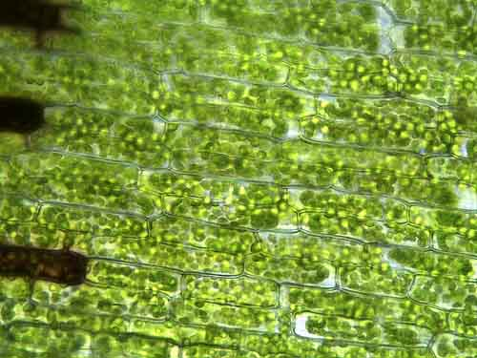
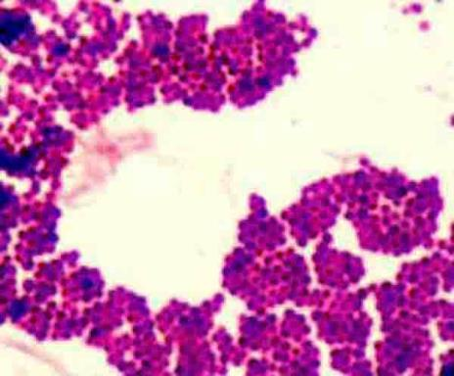
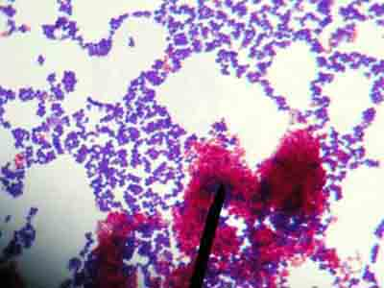
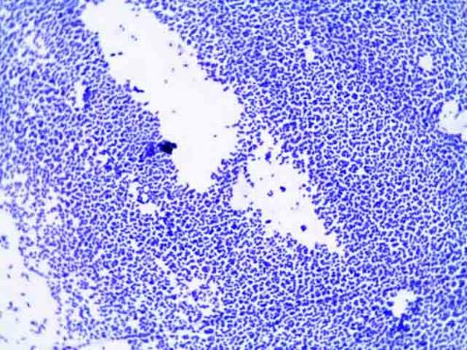
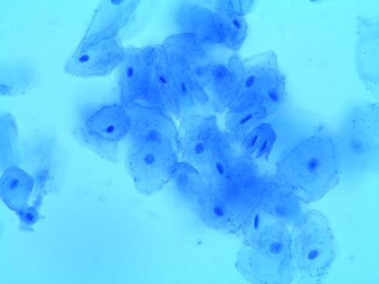
Can you identify whether cells are eukaryotic or prokaryotic?
B
C
A
D
E
F
Notes:
A – Eukaryotic (Elodea cells)
B – Prokaryotic (Staphylococcus epidermidis)
C – Eukaryotic (Epidermal onion cells)
D – Prokaryotic (Mycobacteria (pink) and Staphylococcus)
E – Prokaryotic (E. coli)
F – Eukaryotic (Human cheek cells)
The eukaryotic cells all have a cell membrane visible and membrane bound organelles such as a nucleus or chloroplasts.

Slide 16
Eukaryotic and Prokaryotic Cells
Ribosome
Complete the worksheet by:
1. Labelling the features of eukaryotic and prokaryotic cells
2. Filling in the table to show which features are found in eukaryotic and prokaryotic cells
Cytoplasm
DNA loop
Plasmid
Cell membrane
Cell wall
Notes:
Purpose: students apply new knowledge. Mark schemes provided for students to self or peer assess work.
The worksheet refers to a bacterial slime capsule; this may cause confusion to students learning to identify the cell wall and the cell membrane so delete from worksheet if appropriate.
Point of note/misconception – there is a lot of inconsistency in textbooks etc as to the inclusion of vacuoles in animal cells. Animal cells can form membrane bound vacuoles for storage but do not have permanent vacuoles so for the purpose of this task they will be referred to as permanent vacuoles and are in plant cells only
Stretch for very able pupils could include more detailed cell organelles (Golgi body, Rough/Smooth ER, lysosomes) but these are not expected to be known at KS3 or 4.

Slide 17
Answer the questions below.
Which of these is an example of a prokaryotic cell?
A. Animal cell
B. Plant cell
C. Bacterial cell
2. What is the relative size of eukaryotic cells and prokaryotic cells?
A. Prokaryotic cells are larger than eukaryotic cells
B. Eukaryotic cells are larger than prokaryotic cells
C. Prokaryotic cells and eukaryotic cells are roughly the same size
3. What is the difference between eukaryotic and prokaryotic cells?
A. Eukaryotic cells contain DNA within a nucleus, prokaryotic cells contain DNA in loops and plasmids
B. Eukaryotic cells contain DNA in loops and plasmids, prokaryotic cells contain DNA within a nucleus
C. Prokaryotic cells contain mitochondria to provide them with energy so they can move
✓
✓
✓
Notes:
Purpose: to find out if students are able to answer key questions that check for understanding of the new information that has been covered.
Suggested guidance:
Give students thinking time and then ask for feedback – either holding up fingers for the right number/letter, using mini whiteboards or just writing answers down in books quickly before cold calling.
Answers
Q1. Answer: C
If pupils answer A or B they have misunderstood the definition of a prokaryotic cell.
To fix it revisit definitions of a eukaryotic/prokaryotic cells and highlight the prefix ‘eu’ that means true/all. Alternatively rhyme ‘eu’ with ‘you’ so eukaryotic cells make up you or what you can see ie animals and plants.
Q2. Answer: B
Incorrect answers pupils may have the misconception that cells are the simplest form of life, what they have learnt about so far are plant and animal cells so think they are smaller. To fix it remind pupils that prokaryotes are on average 10 times smaller than eukaryotes and that they are often the size of a nucleus or mitochondria thus are too small to contain either.
Q3. Answer: A
If students answer C they have been distracted by the new information and assume that mitochondria and flagellum must go together to allow the bacteria to move. To fix it, it may be useful to recap the structures of both types of cells, followed by questioning to ensure they can identify the features/relative sizes.

Slide 18
Lesson B3.1.2
What was good about this lesson? | What can we do to improve this lesson?
Send us your feedback by clicking this link
or by emailing sciencemastery@arkonline.org
Thank you!

